Slide 1

When do our customers settle their invoices? IBM Late Payment
By: Ensieh Bahrami

Slide 2
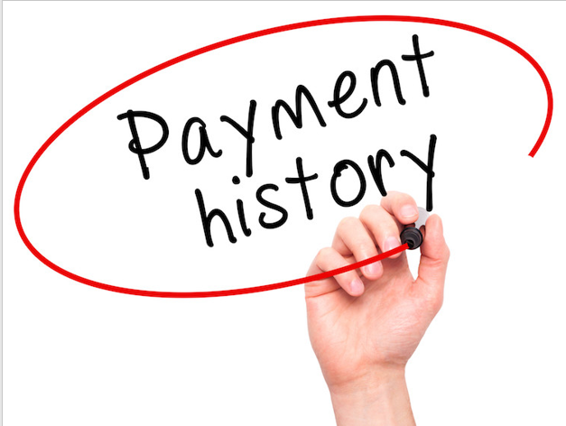
History of 2466 invoices
Issued for 100 customers in 5 countries
All invoices were issued 30 days before due date
Some of disputed invoices were paid before due date
Paperless invoices were issued before or after invoice date
Customers received paper or electronic bills
Invoices issued between 2012 and 2013 with due date between 2012 and 2014

Slide 3
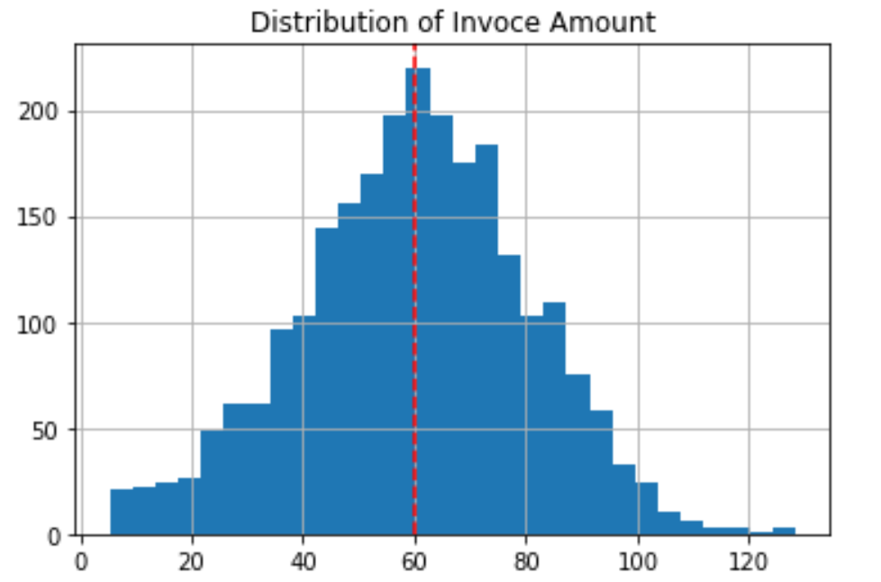
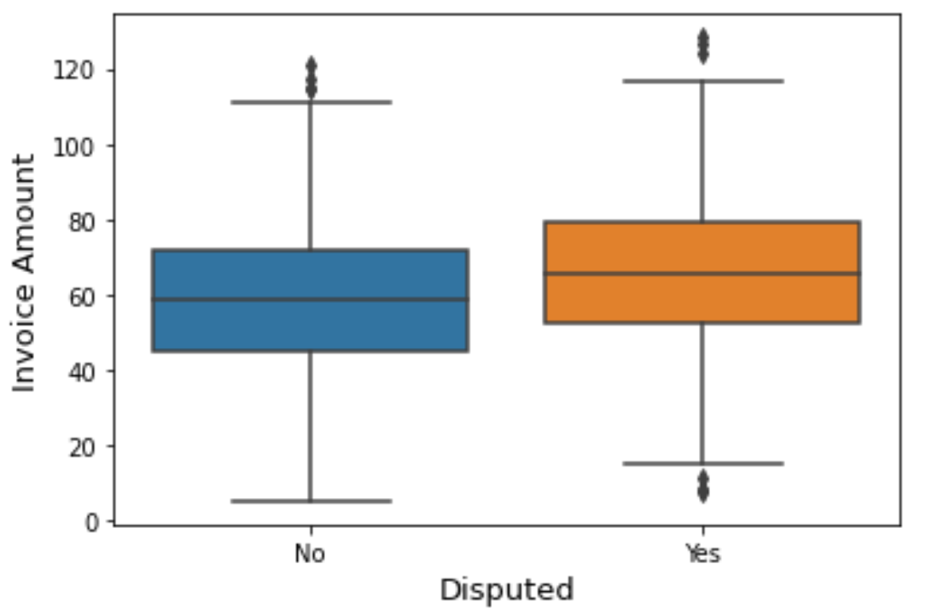
Disputed Invoices with Higher Mean of Amount
Normal distribution of invoice amount

Slide 4
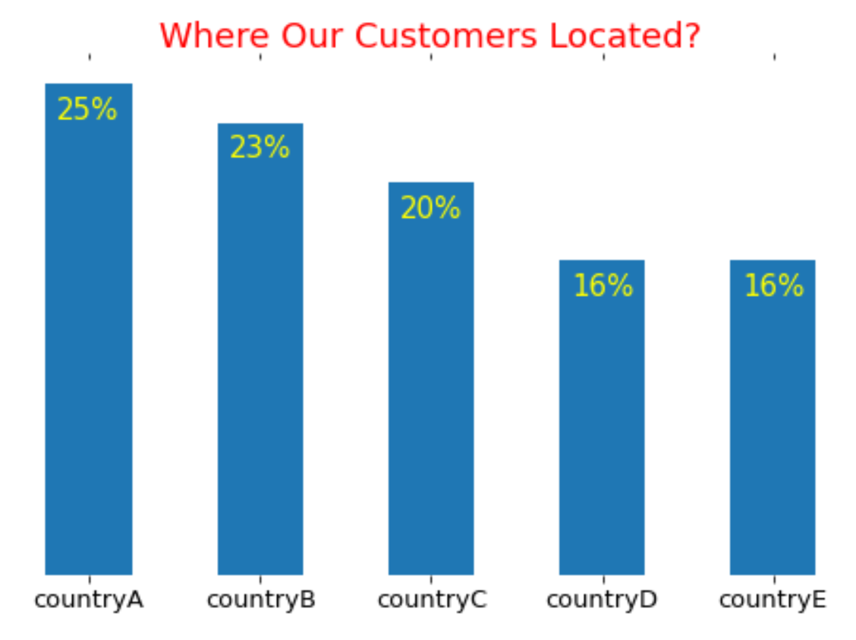
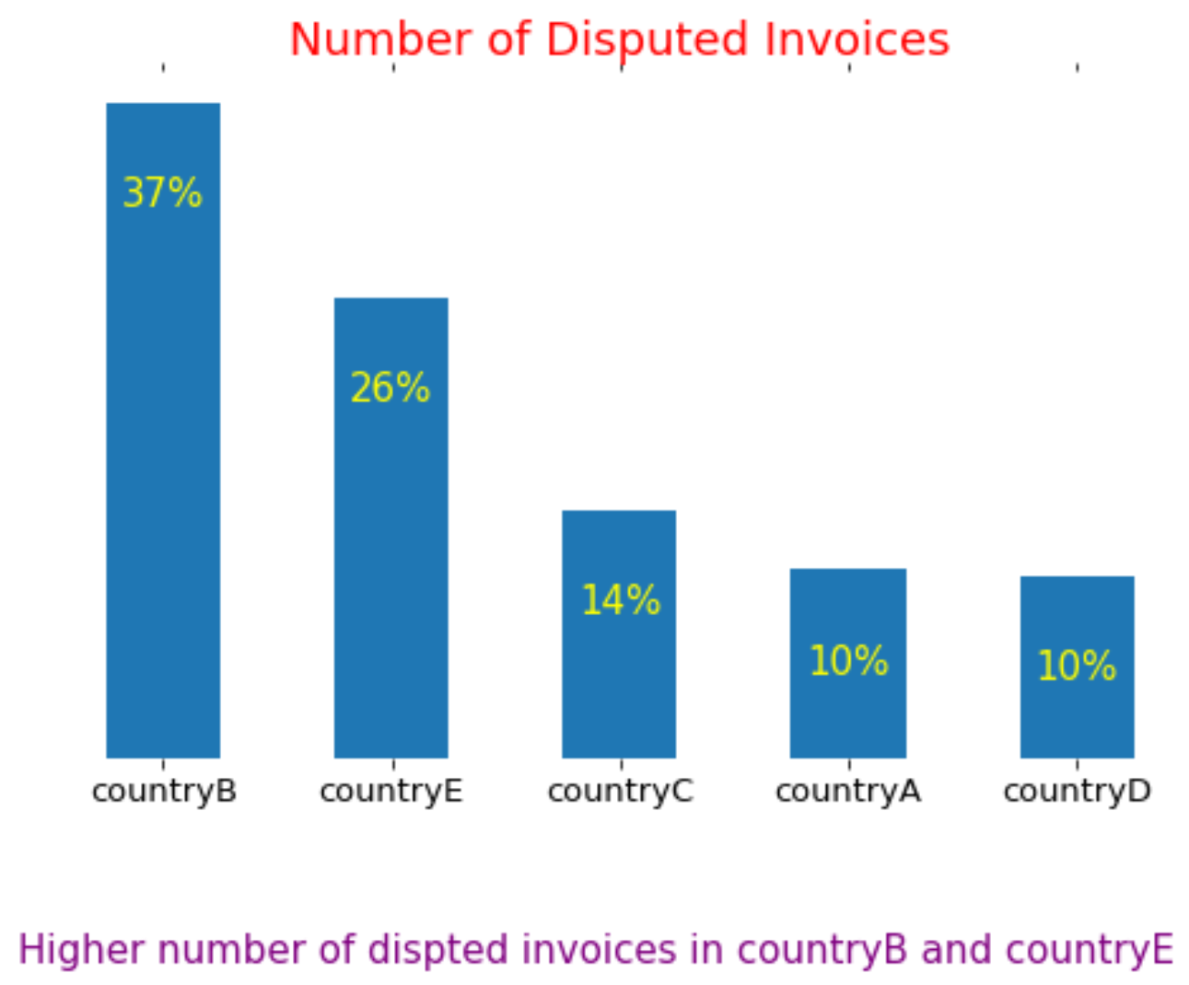
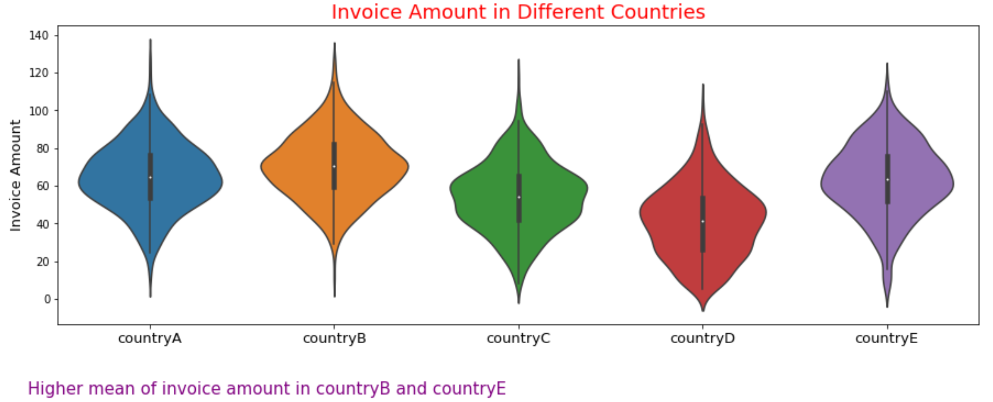
Invoice Amount Has Higher Impact than Location on Disputation

Slide 5
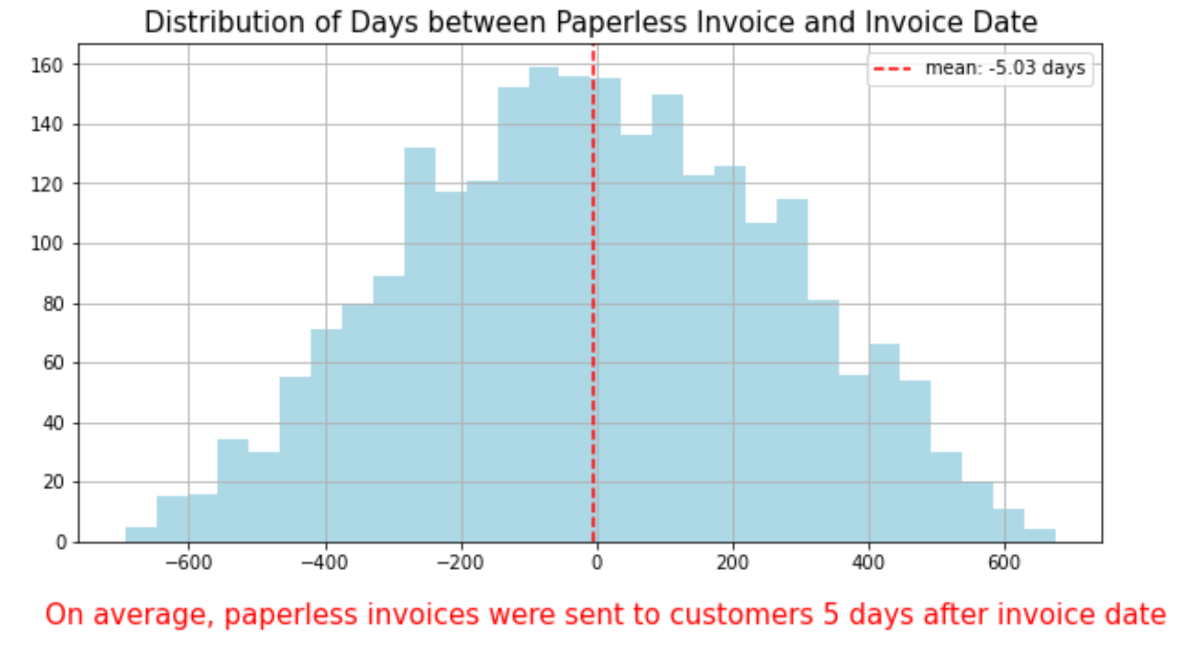
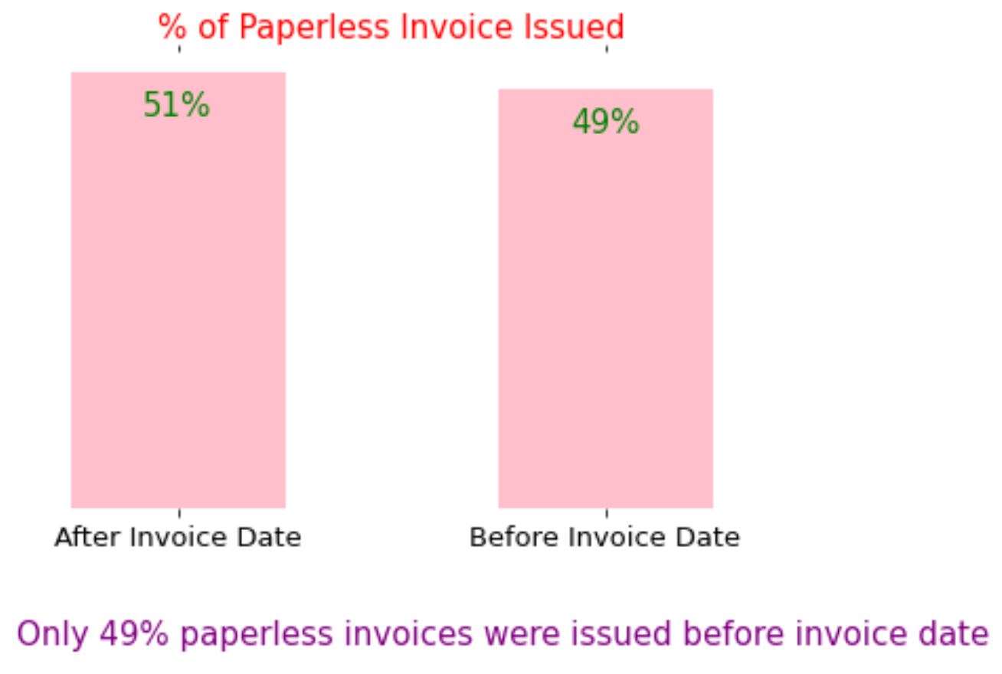
51% of Paperless Invoices Sent on average 5 Days after Invoice Date

Slide 6
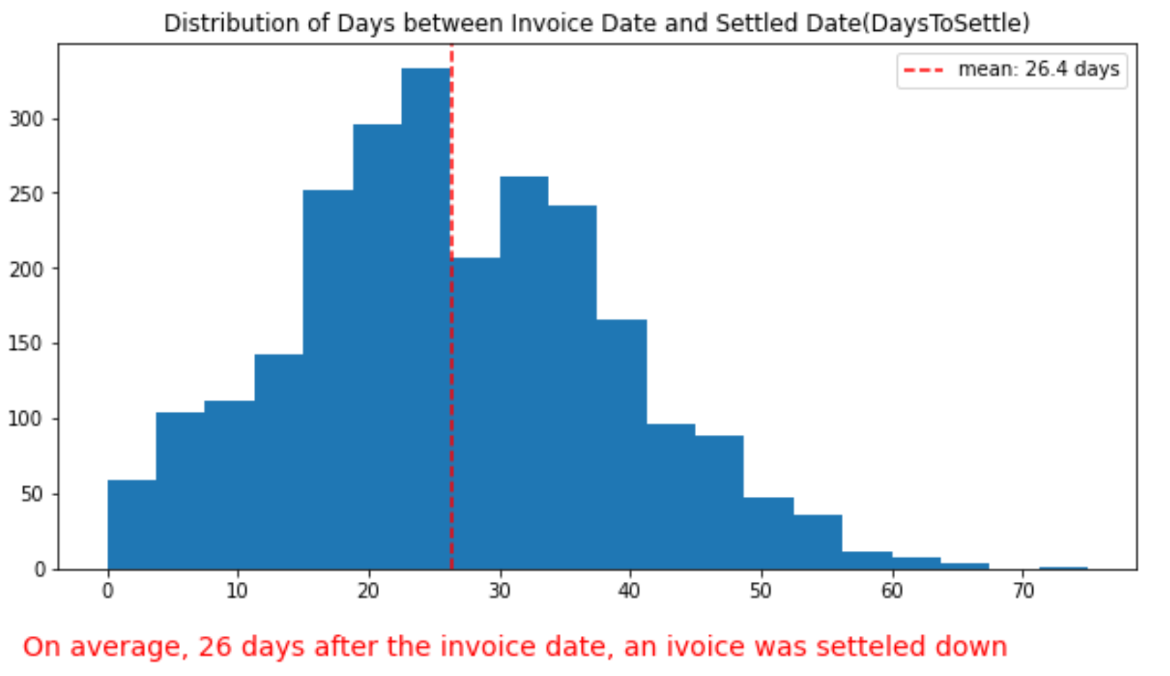
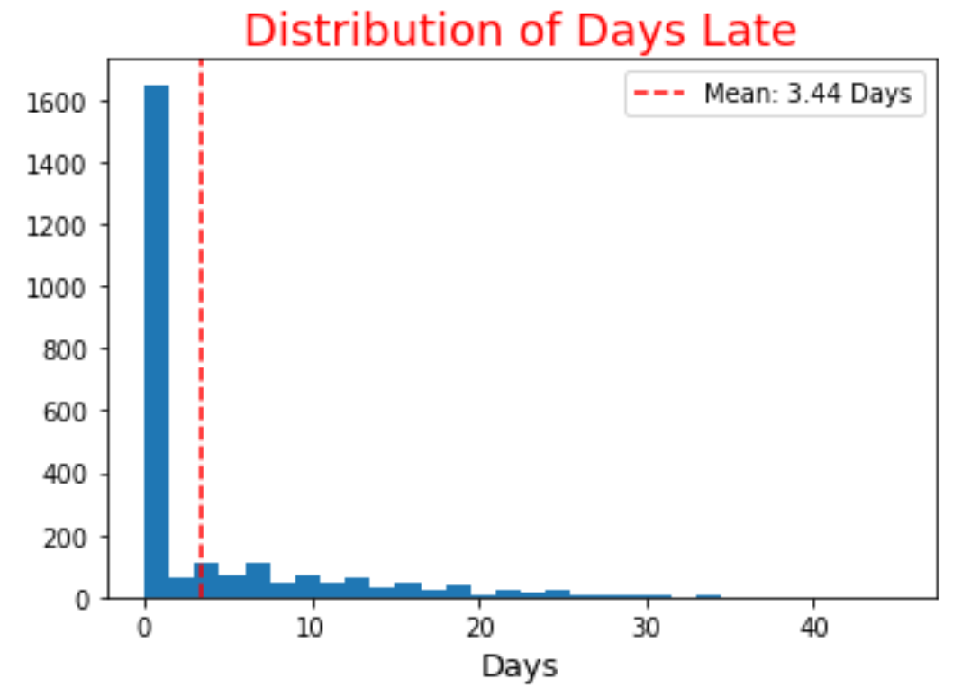
Late Days with Mean of 3 Days Distributed after 30 Days

Slide 7
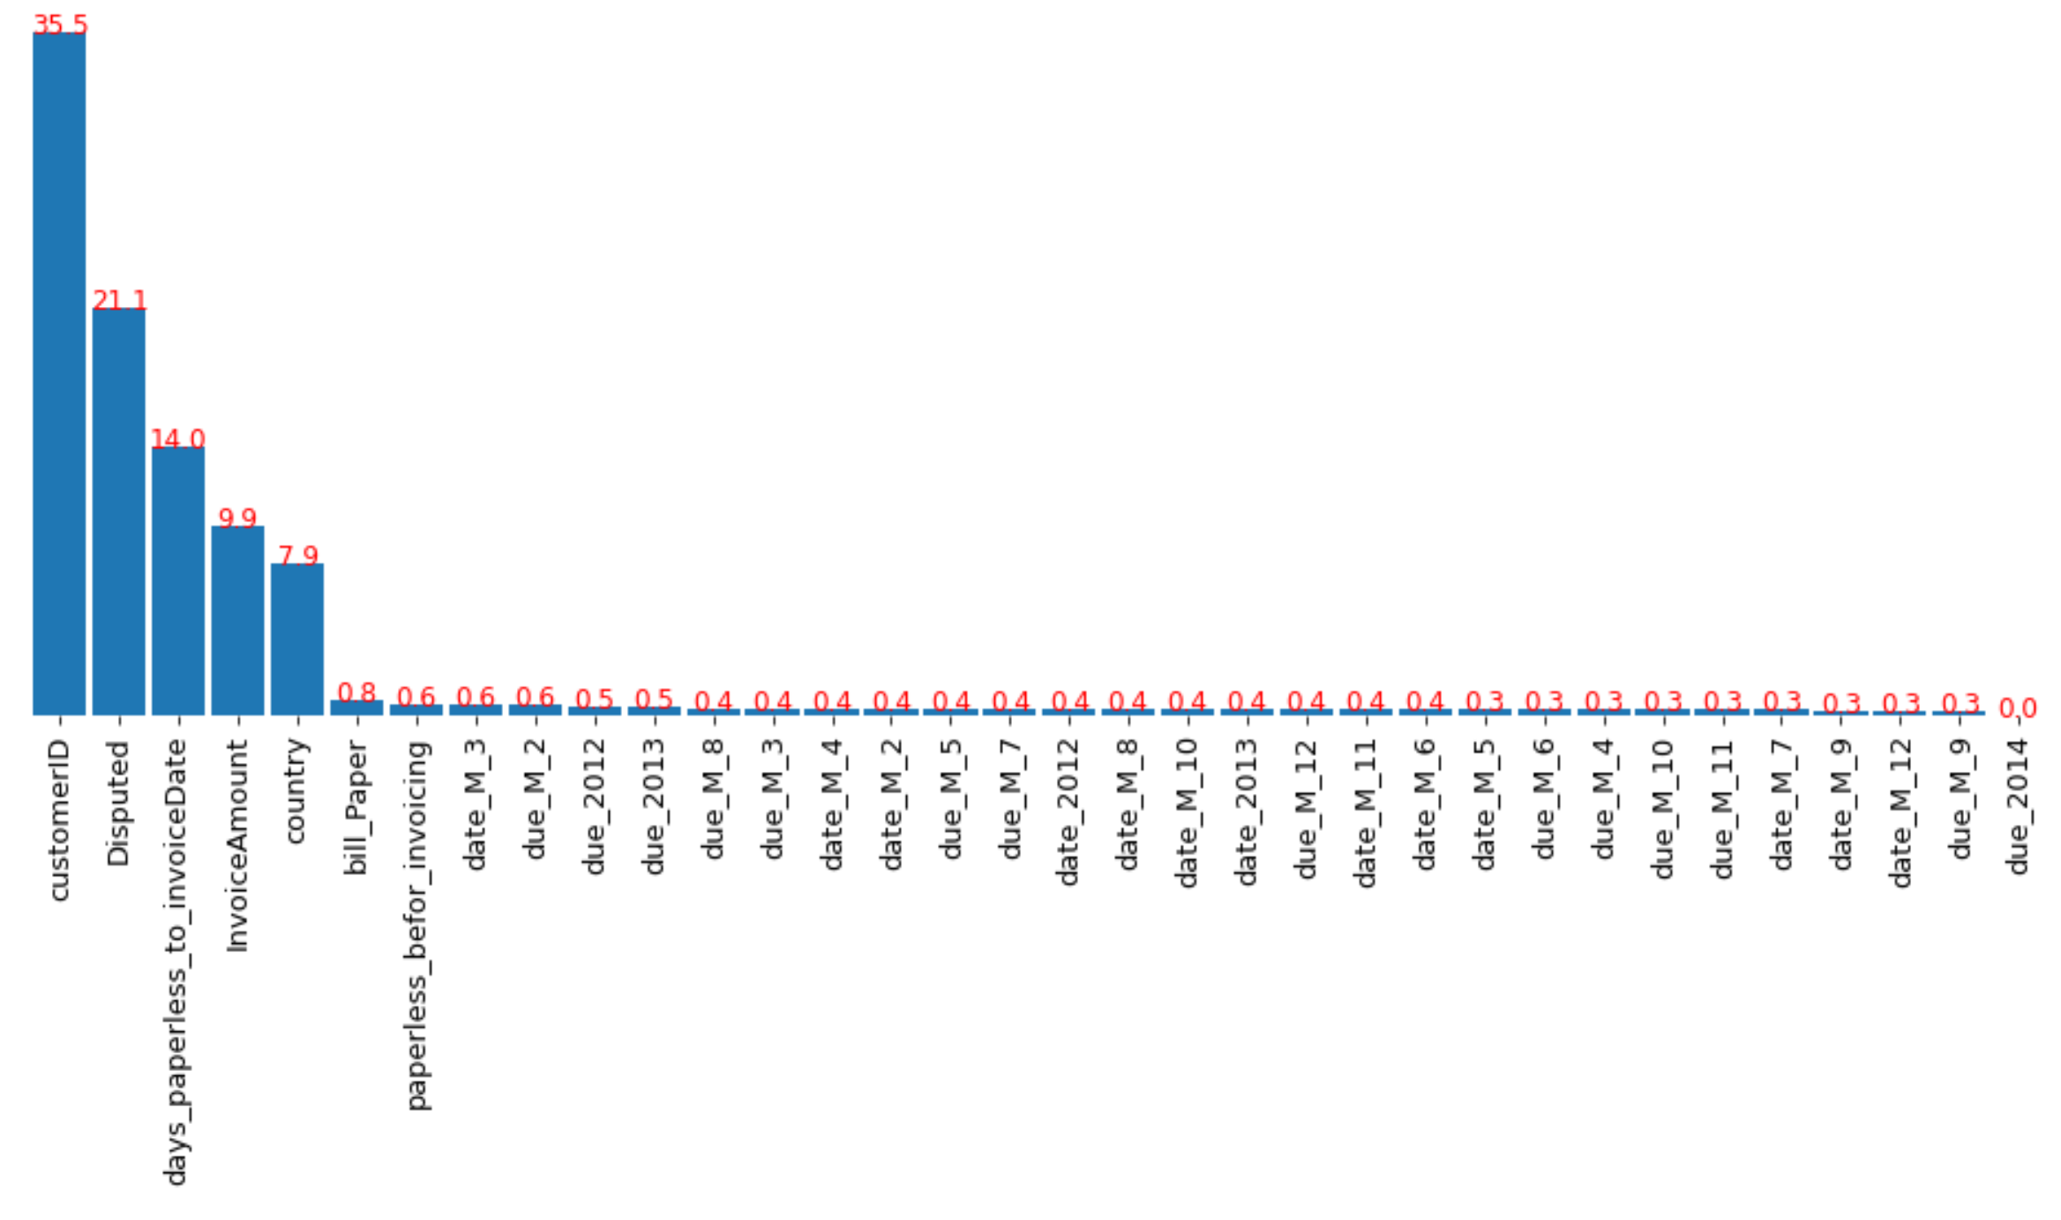
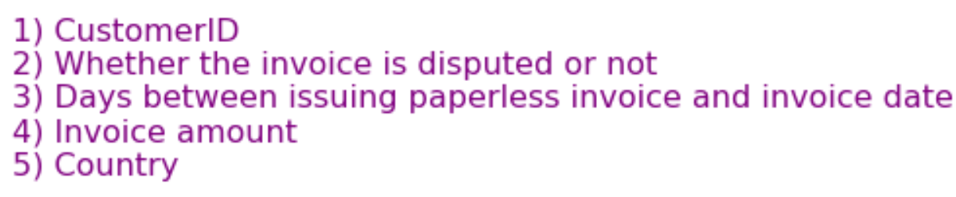
Most Important Features on Predicting Days to Settle

Slide 8
Tuned RandomForest Regressor
Predicts Days to Settle with:
61% Confidence
Mean Absolute Error of 5.62 Days
Root of Mean Squared Error 7.34

